Slide 1
Assumptions
As there is code available ,bringing HDInsight Kafka cluster in the ingestion layer
Assuming the web app is deployed one region.
Image processing thru kafka is not advisable but as mentioned the solution is available ,hence using the kafka in hd insight.
Processed image is stored in the blob storage , where we can enable life cycle management to retain an image for 7 days
Image and customer details are stored in synapse analytics for future analysis purposes
Azure analysis services is not required if the data volume is not higher
Power Bi can take data from synapse directly or from azure analysis services based on the volume of the data.

Slide 2




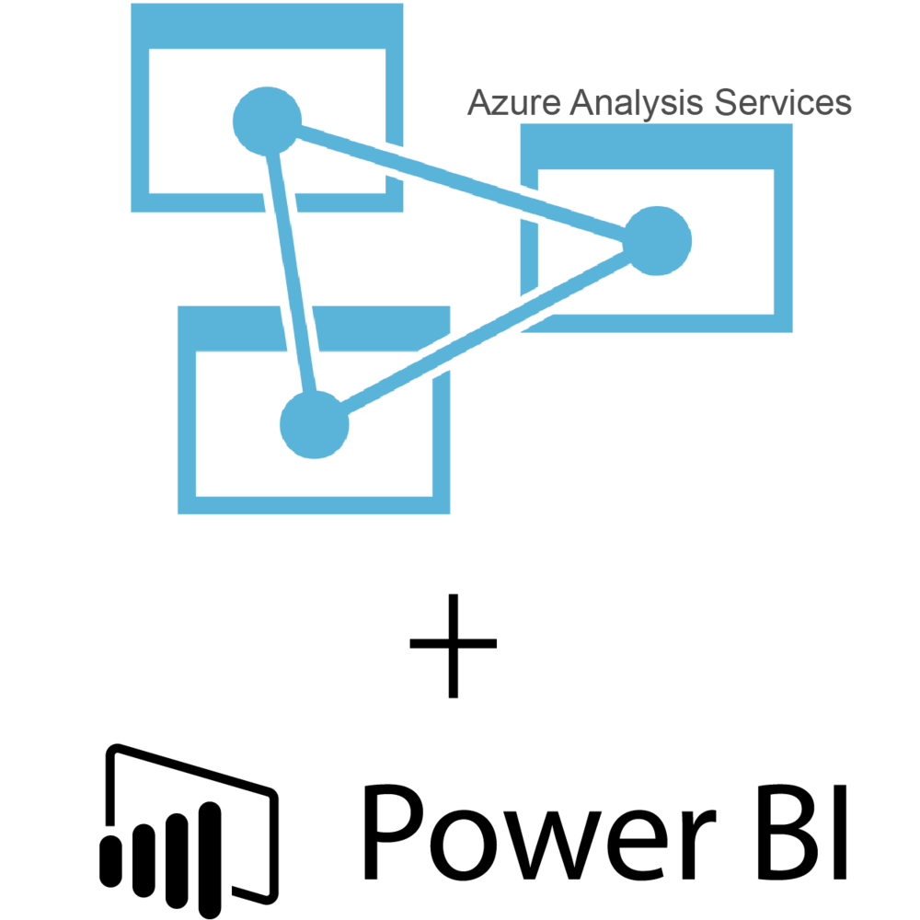

Source Producer
Ingestion
STORE
Analysis
Presentation
Hdinsight Apache Kafka Cluster
User Application Produces Kafaka messages

